Slide 1
Strategies to Build Culture & Increase Engagement September 28, 2023
Notes:
VIRTUAL SESSION: Welcome (1 min) – 1 out of 3 sessions in a series. The first of 3 sessions focuses on building culture and increasing students’ engagement in lessons.
ATTENDANCE – shorturl.at/CEJW8 [CHAT IT IN & CAPTURE PARTICIPANT INFO]

Slide 2
Welcome and Get to Know You
Chat In Your Responses (2 min)
Name and position
Favorite thing about fall
Win from the first weeks of school
Focus area for growth for 2023-24

Slide 3
Agenda
Introductions and Welcome
Strategy 1: Strong Start Routine
Strategy 2: Mutual Respect – Precise Praise, Positive Framing
Strategy 3: Engagement – Radar, Change the Pace
Thank you and Survey
Notes:
JD
1 min – we’ll cover 3 strategies today that will set students up for success on SBAC & give them systematic ways to attack word problems.

Slide 4
Our Mission
Navigator Schools equip students to become learners and leaders in high school, college, and beyond. We develop top tier teams of educators who continuously improve and innovate schools that deliver phenomenal outcomes for all students regardless of their circumstances.
Notes:
JD
Our mission is twofold – to develop our students & to achieve that outcome, we believe we must have the best trained educators.

Slide 5
Our Influencers
Navigator Schools’ instructional strategies are influenced by and adapted from the following resources and organizations.
Notes:
JD
INFLUENCERS:
-we thank the following organizations and texts for guiding us, as we created our model of instructional coaching. These resources & organizations were references, as we designed an effective/impactful school model.
-NOTE – to give appropriate credit and attribution to the organizations & resources, slides will have an image of the resource referenced in the bottom left corner of the slide that the content came from.

Slide 6
Best Practices Workshop Series
Every Student, Every Lesson Series:
Session 1: Build Culture, Influence Engagement
Session 2: Differentiate Instruction
Session 3: Increase the Rigor

Slide 7
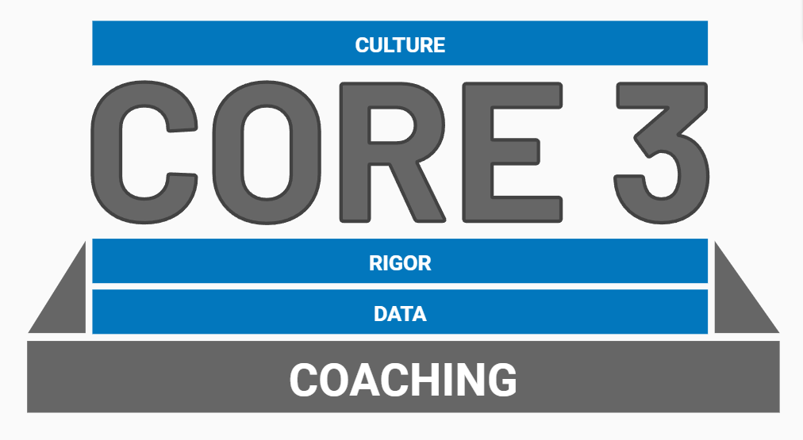
Navigator Core3
Notes:
Intro the core3, focus for the session today is on the domain of culture and each of the sub-domains within it.

Slide 8
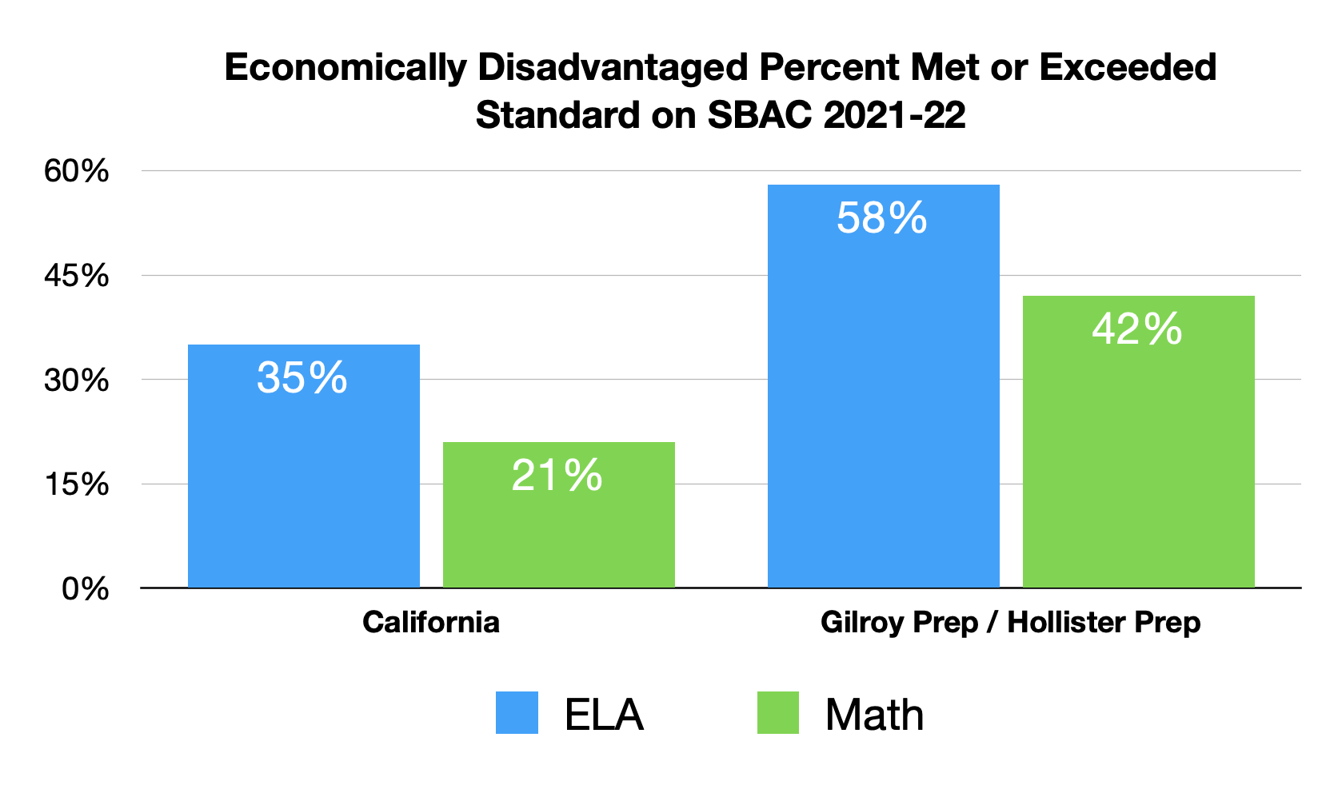
Our Results
Notes:
JD

Slide 9
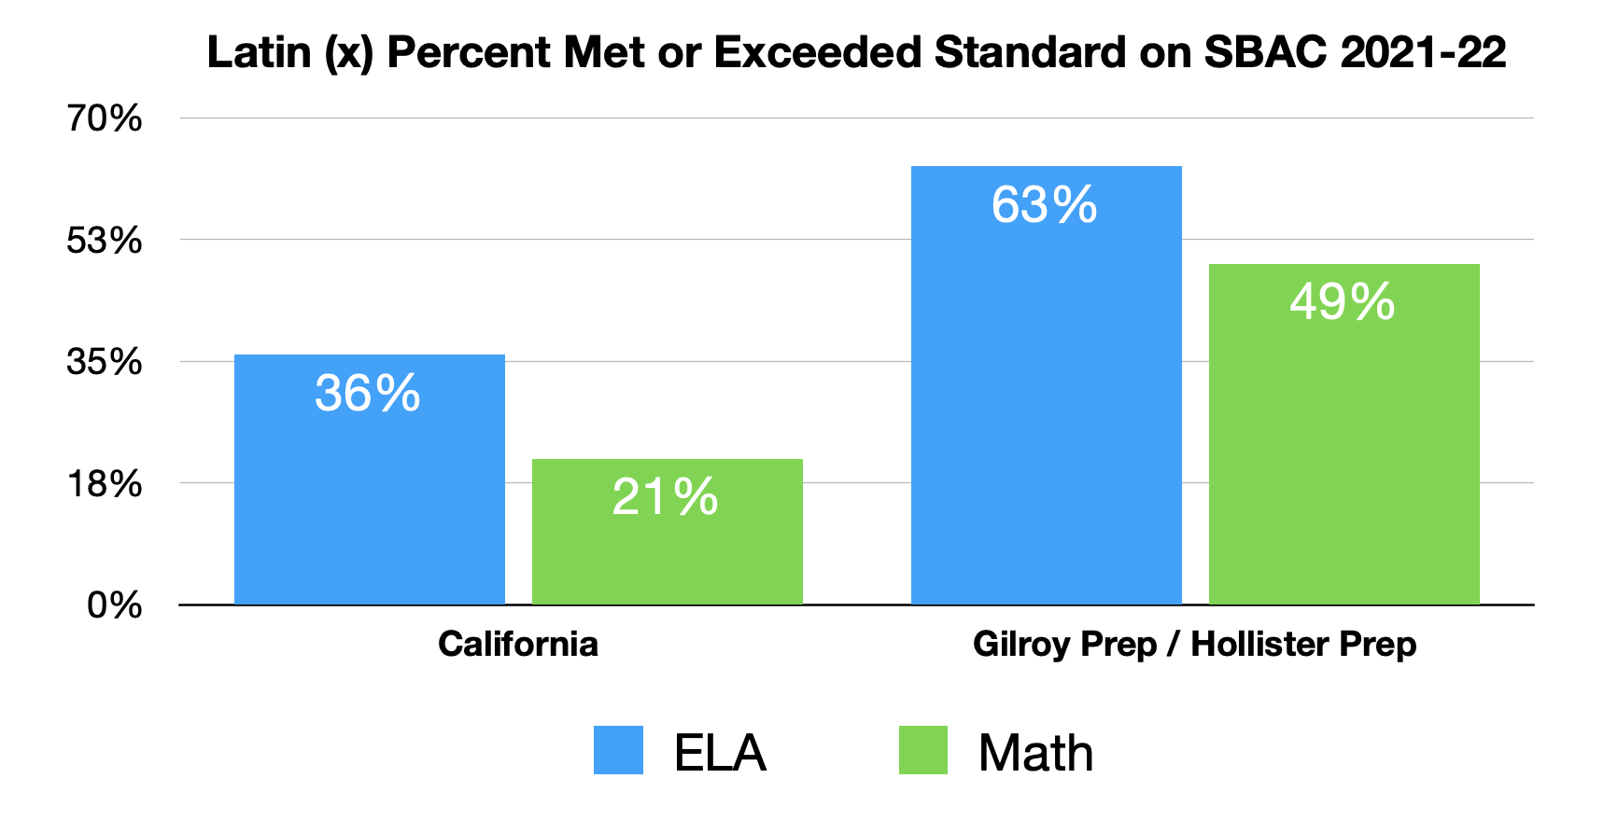
Our Results
Notes:
JD

Slide 10
Agenda
Introductions and Welcome
Strategy 1: Strong Start Routine
Strategy 2: Mutual Respect – Precise Praise, Positive Framing
Strategy 3: Engagement – Radar, Change the Pace
Thank you and Survey

Slide 11
Resources / Materials
Link to Participant Handouts: shorturl.at/fCLTU
Google Drive will prompt to make a copy of the handouts

Slide 12
See It | Strong Start Routine
What impact does a strong Do Now have on student learning?
How might it impact the rest of the lesson?
Link to video:
shorturl.at/ozAUV

Slide 13
See It | Strong Start Routine
What impact might a strong start routine have on the classroom culture?
How might it impact the rest of the block?
Link to video:
shorturl.at/lQTX2 [watch to 3:00]

Slide 14
Core Idea
A Strong Start Routine allows learning to begin even before you start teaching.

Slide 15
Name It | Strong Start Routine
Preparation
Prepare ‘Do Now’ before students enter classroom
Establish a ‘materials’ procedure from entry-to-Do Now
Walk the routine, identify problem spots
Content Sources – make it rinse & repeat
Extra curriculum problem sets
Math & reading fluency practice drills
Other ideas?

Slide 16
Name It | Strong Start Routine
Components of Strong Start Routine
Same Every Day: Be consistent about where you post your Do Now, so that finding it right away becomes a habit.
Self-Managed: Arrange materials, prepare directions for independence.
Short and Sweet: Lasts 5-7 minutes and students produce written work.
Review or Preview: Reinforces mastery of previous content or previews standards/content coming up.

Slide 17
Do It | Plan Your Strong Start Routine
Preparation
What are the 1-2 sources of your ‘Do Now’ content?
What will students produce at the end of your Do Now?
What is the step-by-step procedure for materials?
Components of Strong Start Routine
Where will you post your Strong Start directions?
When will you update your Do Now materials? (daily, weekly, etc.)
If you will review content, how will you prioritize standards?

Slide 18
Core Idea
A Strong Start Routine allows learning to begin even before you start teaching.

Slide 19
Agenda
Introductions and Welcome
Strategy 1: Strong Start Routine
Strategy 2: Mutual Respect – Precise Praise, Positive Framing
Strategy 3: Engagement – Radar, Change the Pace
Thank you and Survey

Slide 20
Resources / Materials
Participant Handout [from earlier in session]

Slide 21
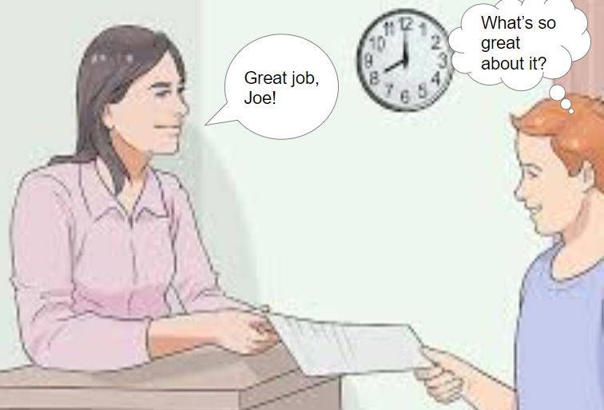
Thought Question
Chat It In
How could a statement like “great job” hinder student motivation?

Slide 22
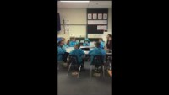
See It | Precise Praise
How does Precise Praise benefit other students in the class?
What effect do the teachers have on the students and the class environment?
Link to video:
shorturl.at/lLMQ4

Slide 23
Name It | Precise Praise
Precise Praise is strategic and authentic praise that motivates student behavior - “it is specific, genuine, real, and encouraging.”
Given to individual students
Other students benefit from example
All students reminded of the expectation
Individual student is proud

Slide 24
Reflect | Precise Praise
Chat It In
Why do you think this technique would be important for student engagement?

Slide 25
Name It | Precise Praise
Acknowledgement - student recognition for doing what’s expected of them
Praise - recognition when students exceed your expectations
Private or Public - recognition to the student quietly and privately OR publicly said for the class to hear
Aligned to Lesson Objective - recognition of specific academic actions that support the objective
Reinforce Actions, Not Traits - reinforce behaviors and actions that students can choose to repeat

Slide 26
Do It | Precise Praise
Script Precise Praise for the first 5 minutes of a classroom entrance.
What behaviors do you want to see?
How will you use Precise Praise to reinforce those behavioral expectations?
“Thank you [____] for [____].”

Slide 27
Do It | Precise Praise
Practice giving your Precise Praise to your students as they enter the classroom.
Breakout Rooms | groups of 3
Step 1: Teacher practices script (45 seconds)
Step 2: Coach gives a glow and a grow (30 seconds)
Step 3: Teacher does it again incorporating feedback (30 seconds)
Step 4: Switch roles
Roles: teacher, student, coach

Slide 28
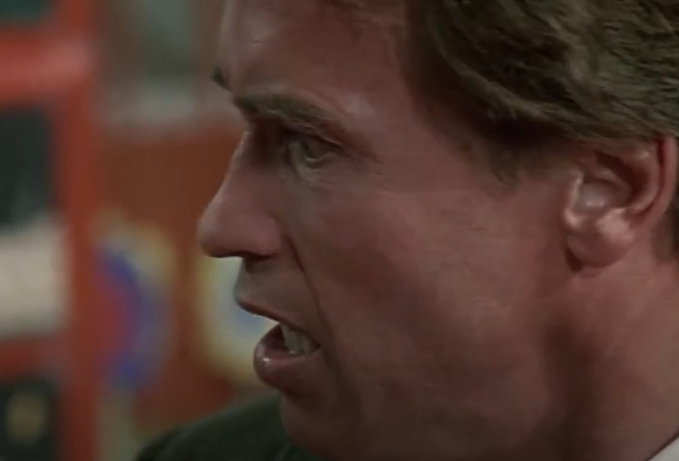
Thought Question
Chat It In:
How do the kindergarteners react to the teacher?
Link to video:
shorturl.at/gjKXY

Slide 29
See It | Positive Framing
Chat It In
How does the teacher guide student behavior?
What type of positive wording did the teacher use?
Link to video:
shorturl.at/ozAUV

Slide 30
Name It | Positive Framing
“Positive Framing means using positive language to motivate and inspire students when you are making corrections or encouraging them to sustain effort.”
Positive corrections to student behavior
Motivates students
Positive outcome
Improving in a positive way

Slide 31
Name It | Positive Framing
Live in the Now - focus on moving forward classroom activities instead of dwelling on the past
Assume the Best - never assume all negative actions are on purpose
Allow Plausible Anonymity - begin by correcting without using names

Slide 32
Name It | Positive Framing
Narrate the Positive & Build Momentum - use your words to push students forward
Challenge! - Healthy competition is a good thing!
Talk Expectations & Aspirations - your praise helps build them up

Slide 33
Reflect | Positive Framing
Chat It In:
What is the difference between Precise Praise and Positive Framing?

Slide 34
Examples | Positive Framing
Positive Framing helps to communicate least invasive interventions in a respectful way.
Examples | Non-Examples
Marco, I want to see that pencil working. | Marco, stop looking at Nathan.
Charles and Isabel are ready to work, they can’t wait to start their math facts. | Some of us are not ready and fooling around.
I am glad to see so much enthusiasm for getting started. Please wait until Samia has finished her question. | Don’t shout out, Samia is trying to talk.
Fourth grade make sure you are in SLANT with your notes in front of you. | Jason, I want to see you on slant with your notes Jason why haven’t you finished your notes

Slide 35
Agenda
Introductions and Welcome
Strategy 1: Strong Start Routine
Strategy 2: Mutual Respect – Precise Praise, Positive Framing
Strategy 3: Engagement – Radar, Change the Pace
Thank you and Survey

Slide 36
Thought Questions
Chat It In
What are some of the students doing during the lesson?
What is the teacher doing?
Link to Video:
shorturl.at/pxDLU

Slide 37
See It | Radar
Chat It In
What is the teacher doing?
What are students doing?
Link to Video:
shorturl.at/dKLS2

Slide 38
Reflect | Radar
Chat It In
Why do you think Radar would be important for student engagement?

Slide 39
Name It | Radar
Teacher watches every move and can redirect to support:
Accountability
Positive Behavior
Teacher looks with a purpose
Students stay on task and engaged

Slide 40
Name It | Radar
“Radar is the ability to see what happens in your classroom; Be Seen Looking is your ability to let students know you see what happens. When you see events in the classroom accurately and students know that you do, off task behaviors disappear.”

Slide 41
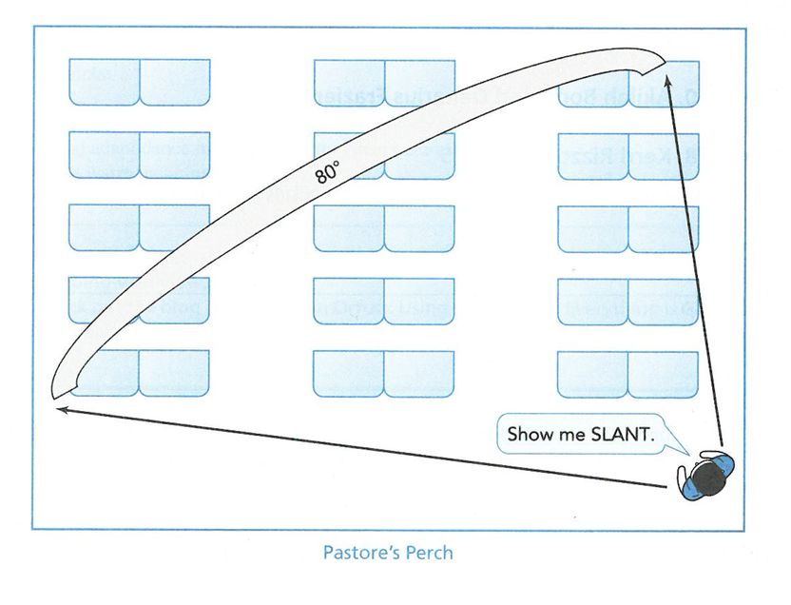
Do It | Radar
Reposition Yourself:
move to a corner of the room for a better vantage point to check whether students follow directions; eliminate ‘hidden spots’

Slide 42
Do It | Radar
Use Your Dance Moves small movements to demonstrate careful looking
Swivel – scan the room methodically
Invisible Column – lean to the sides to get a clear view
Politician – point to students to acknowledge compliance
Sprinkler – scan the room, then snap back in the other direction
Tiptoe – stand on tiptoe to see everything in the back of the room
Quarterback – when crouching with a student, glance around
Disco Finger – trace the arc of your scan with your finger

Slide 43
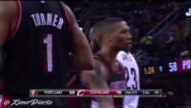
Thought Question
How does the ball handler’s change of pace in basketball affect the defender?
Link to Video:
shorturl.at/adAQ5
Watch: 8:35-9:15

Slide 44
See It | Change the Pace
How is the teacher changing the activities?
When would you try to speed up or slow down instruction? Why?
Link to Video:
shorturl.at/BNWZ6

Slide 45
Reflect | Change the Pace
Chat It In:
Why do you think Change the Pace would be important for student engagement?

Slide 46
Name It | Change the Pace
Changing the Pace “allows you to create the ‘illusion of speed,’ the feeling that the class is moving quickly. Change the Pace involves managing the changes you make to what students are doing during the lesson.
These changes can be in activity type or format.”

Slide 47
Do It | Change the Pace
Switchable Types of Activity
Knowledge Assimilation
Students presented information
Students listen, take notes, ask & answer questions
Guided Practice and Guided Questioning
Task oriented back-and-forth between teacher and students

Slide 48
Do It | Change the Pace
Switchable Types of Activity
Independent Practice
Completing work on their own
Reflection and Idea Generation
Independent, thought-provoking ideas on content
Discussion
Develop ideas as a group – whole class or in small groups

Slide 49
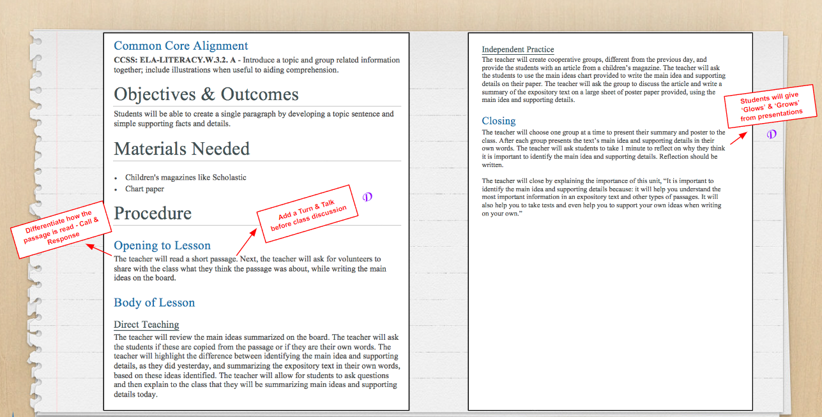
Example | Change the Pace

Slide 50
Thank You
Coming Up: BPW2 – Differentiating Instruction
Thursday, November 9, 2023
Need help or a resource we mentioned today?
Visit navilearning.org
Send us an email
James Dent – james.dent@navigatorschools.org
Marlena Castellanoz – marlena.lopez@navigatorschools.org
Justin Steiner – justin.steiner@navigatorschools.org

Slide 51
Feedback Survey
Please complete the session survey.
Your feedback helps us get better for future sessions.
BPW1 Survey Link: shorturl.at/oJMT8

Slide 52
Thank You!

